Slide 1
Assignment # 02
Noor Fatima
25F-CY-108

Slide 2
Basic atomic theory
INTRODUCTION
All matter is made up of atom. Atom is the smallest unit retaining chemical properties. Atoms consist of: Protons,Neutrons And Electrons
HISTORICAL DEVELOPMENT 1. Democritus (400 BCE) Proposed matter is made of indivisible particles called atomos. Philosophical idea, no experiments.
2. . John Dalton (1803) First modern atomic theory.Atoms of the same element are identical. Atoms combine in fixed ratios.

Slide 3
Historical development
J. J. Thomson (1897) Discovered the electron. Proposed the plum pudding model.
Niels Bohr (1913) Electrons move in quantized orbits. Explained hydrogen spectrum.

Slide 4
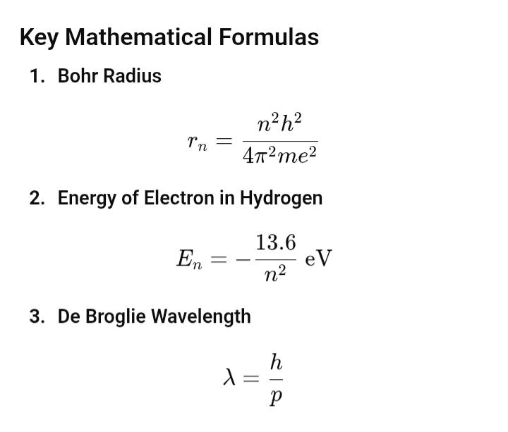
Mathematical formula

Slide 5
Applications
Chemistry and chemical bonding Spectroscopy Semiconductors Lasers Atomic clocks

Slide 6
Introduction to particle physics
Definition Particle physics studies the fundamental constituents of matter and energy and their interactions at the smallest scales.
Historical Background 1897: Electron discovered (J. J. Thomson) 1932: Neutron discovered (James Chadwick) 1950s–60s: Many new particles found → “particle zoo” 1970s: Development of the Standard Model 2012: Higgs boson discovered at CERN

Slide 7
Mathematical formula & APPLICATIONS
THE FORMULA IS GIVEN BY
E=mc²
APPLICATIONS Particle accelerators Medical imaging (PET scans) Radiation therapy Nuclear energy Understanding the early universe

Slide 8
Standard model
DEFINITION The Standard Model is a theory that describes all known fundamental particles and three of the four fundamental forces (excluding gravity).
INTRODUCTION & HISTORY Developed between 1960–1975 Based on quantum field theory Experimentally confirmed with high precision Higgs boson discovery (2012) completed the model

Slide 9
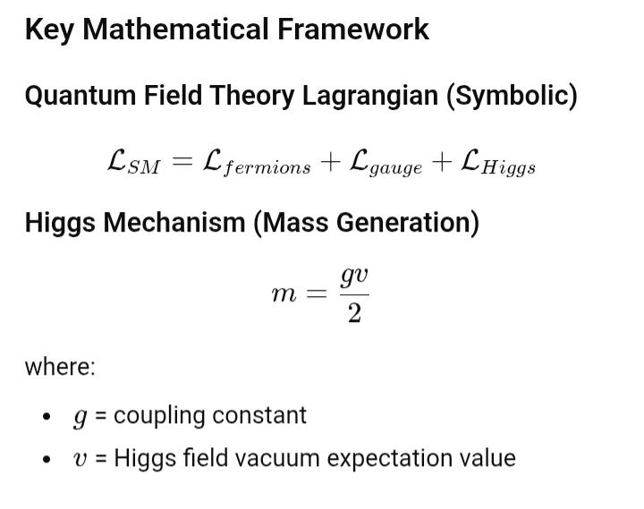
Mathematical formula

Slide 10
Applications
APPLICATIONS Of THE STANDARD MODEL High-energy physics experiments (LHC) Development of quantum technologies Advances in computing and detectors Understanding fundamental laws of nature

